Slide 1
MicroBayes
Probabilistic Machines for Low-level Sensor Interpretation
Emmanuel Mazer Didier Piau Laurent Fesquet Laurent Girin

Slide 2
Agenda
Context
Rebooting Computing
Bambi
Project description
Scientific challenges
Envisioned approaches
Expected results
Dissemination & valorization

Slide 3
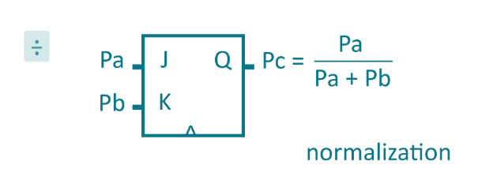
Overall objectives
Use a radically different approach to perform computation : stochastic computing
Outperform standard computer and GPU in term of speed and energy efficiency for Bayesian inference problems
1010011001110100 -> p1=0.5
AND
0010000100000 -> p1.p2=0.125
0010100000101000 -> p2=0.25

Slide 4
CONTEXT

Slide 5
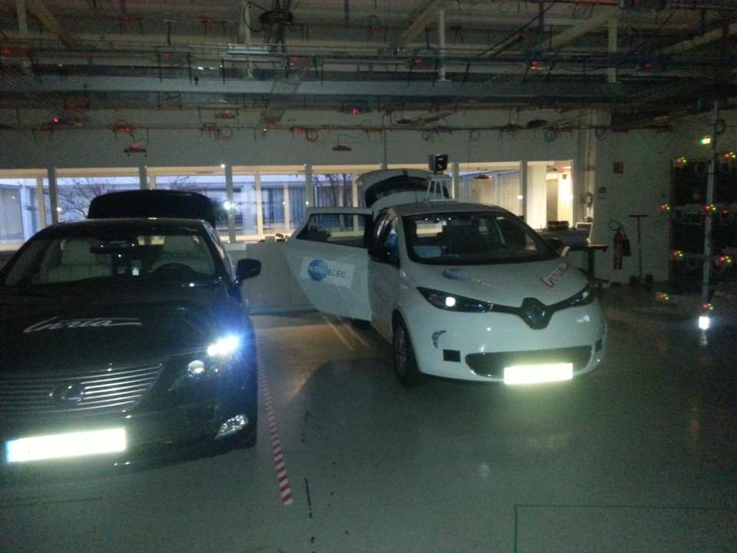
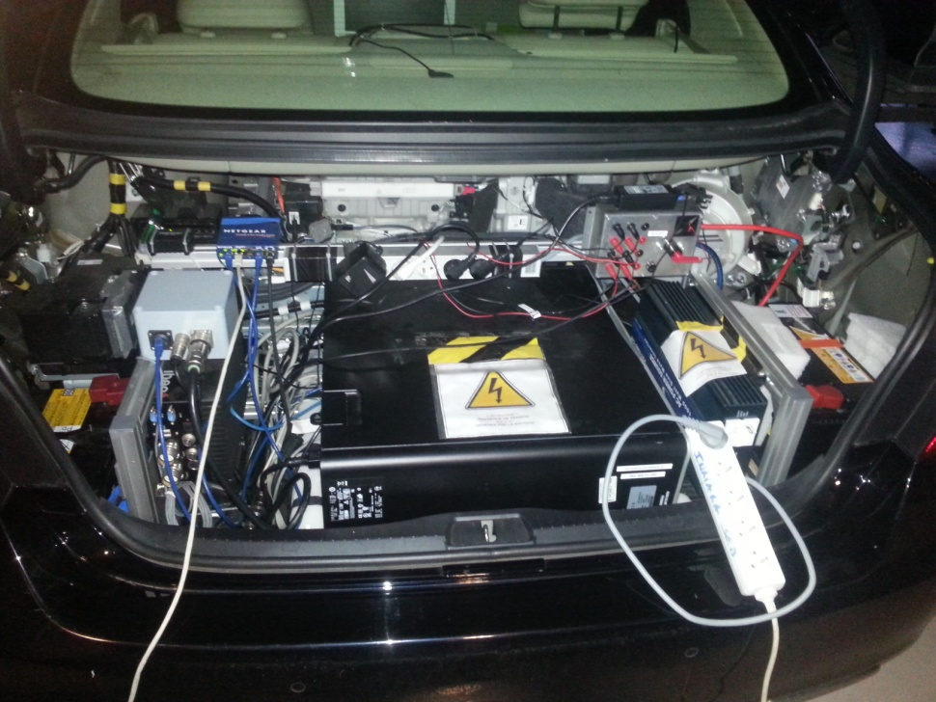
High energy consumption
1 Stéréo Camera
+
2 lidars

Slide 6
Moore's Law limits

Slide 7
Rebooting Computing http://rebootingcomputing.ieee.org/rc-summits/rcs4/presentations

Slide 8
FET Project BAMBI FP7-ICT-2013-C
New hardware thinking:
Telegraphic signal
new device

Slide 9
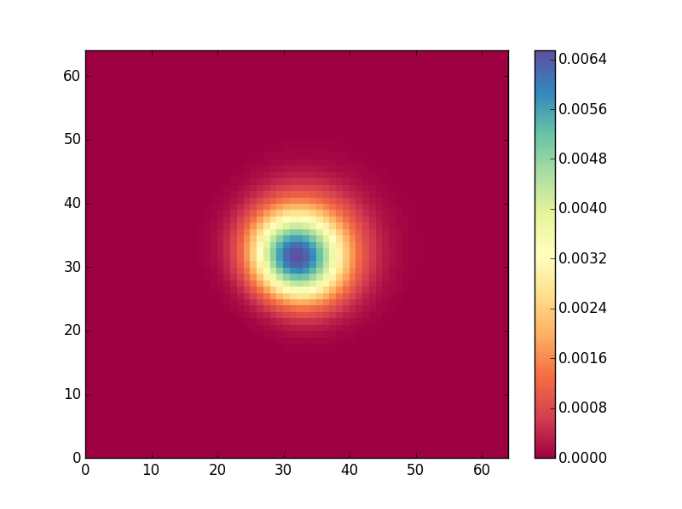
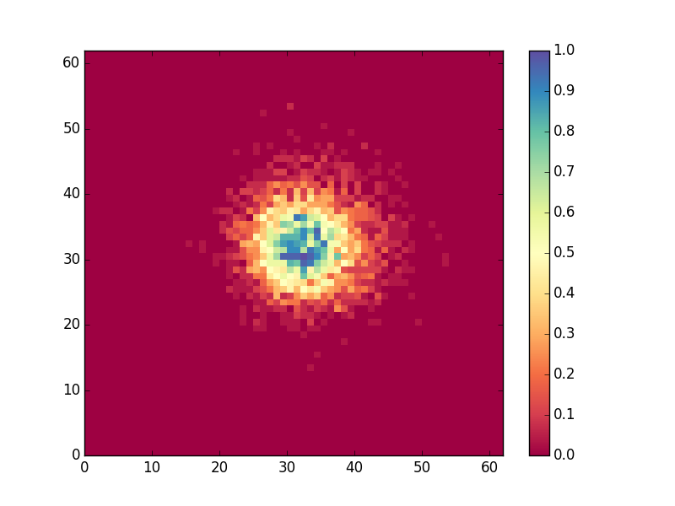
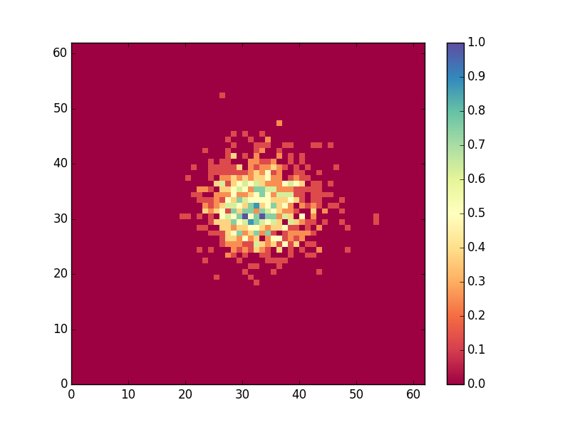
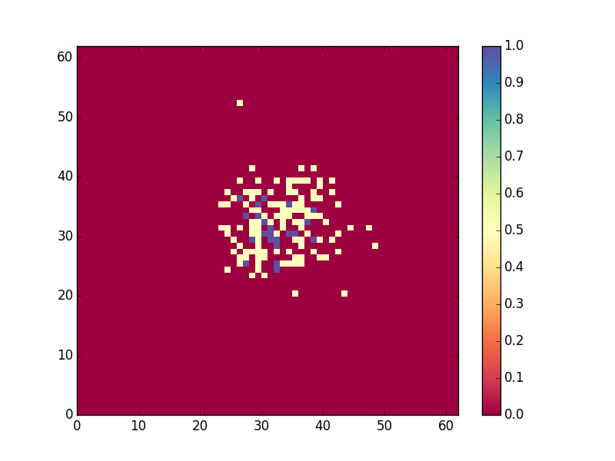
Good results with minimal hardware
Exact inference
N=200: ε <0.01%
N=10
N=10: ε < 0.1%
N=1: ε <2%
ε: mean location precision
N: length of the bit stream used for the priors

Slide 10
MicroBayes Challenges
To design non von Neumann architectures dedicated to the processing of stochastic bit streams.
(b) To study new algorithms for stochastic inference based on generating sets.
(c) To evaluate stochastic machines on difficult Bayesian inference problems related to low-level sensor fusion.

Slide 11
SCIENTIFIC APPROACHES

Slide 12
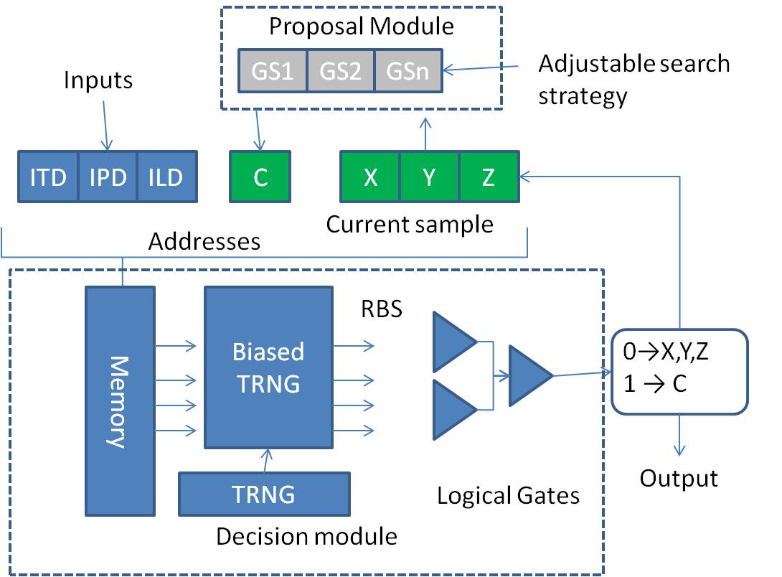
Design of stochastic machines

Slide 13
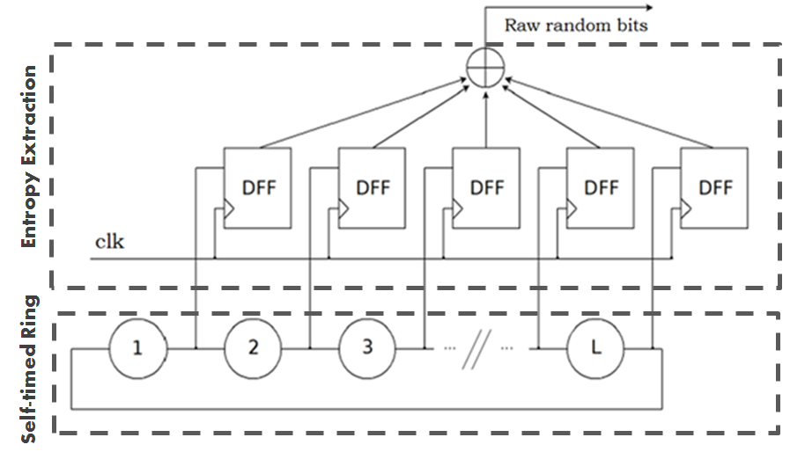
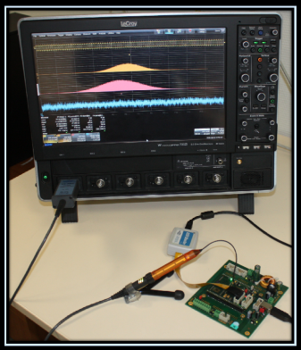
High performance CMOS TRNG
TIMA Self-timed ring based TRNG
Extracts randomness from the jitter of a STR, regardless the jitter magnitude
The design is flexible: area, bit rate and security level can be tuned with a very low design effort
Passes AIS31 and NIST tests at high bit rates (a few hundred Mbit/s)

Slide 14
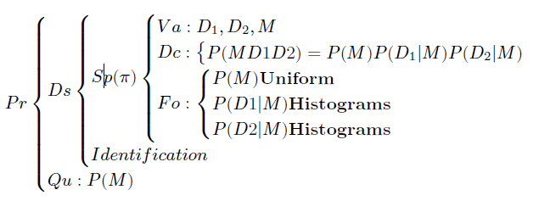
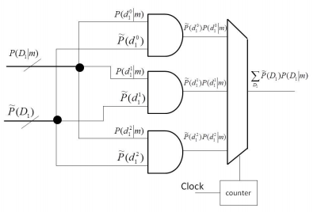
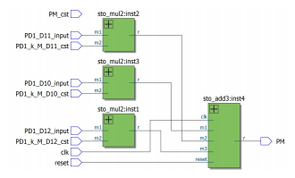
Compilation tool chain for stochastic machines
Bayesian model description
Programming and Algorithmic (ProBT)
Bayesian Inference
VHDL description
Compiler
FPGA:
Field Programmable Gate Array
High level simulator
FPGA

Slide 15
New algorithms for stochastic inference
Realistic problems are leaving in high dimension space.
Stochastic inference is equivalent to explore this space to search for high probability density regions.

Slide 16
MicroBayes : Stochastic Machine with Programmable search strategies
A generating set is a way to entirely explore a given search space.
Choosing one generating set is a way to select an exploration strategy: for example low and large grain exploration.
Exploration strategies may be combined for a particular application.

Slide 17
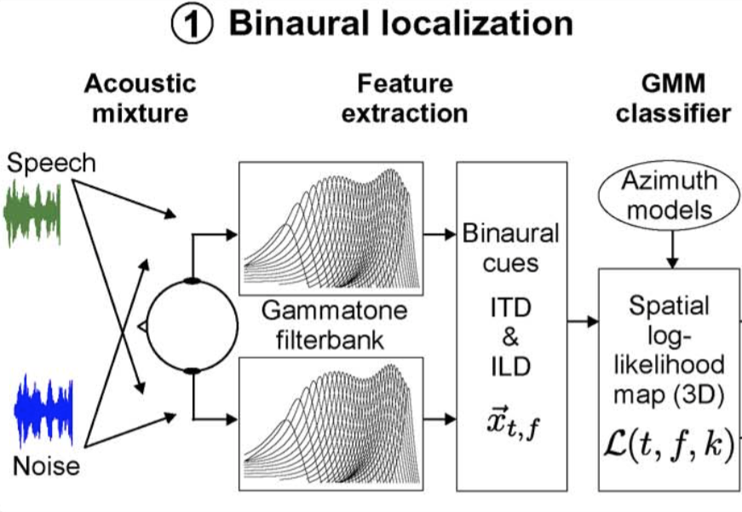
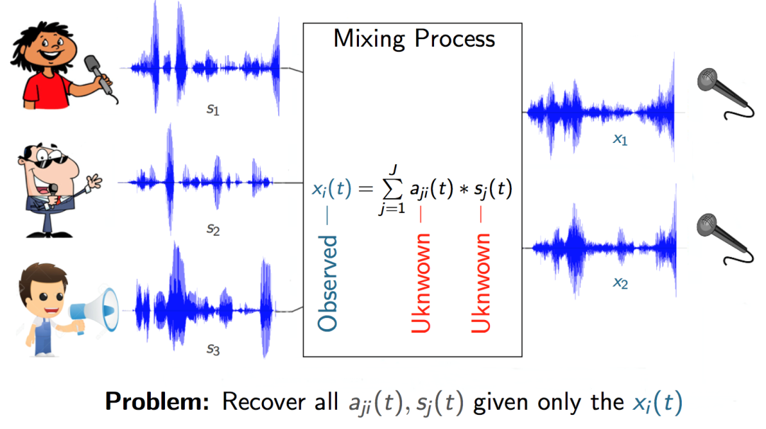
MicroBayes: Evaluate stochastic machines on difficult Bayesian inference problems
Sound Source Localization
Sound Source Separation

Slide 18
ORGANIZATION

Slide 19
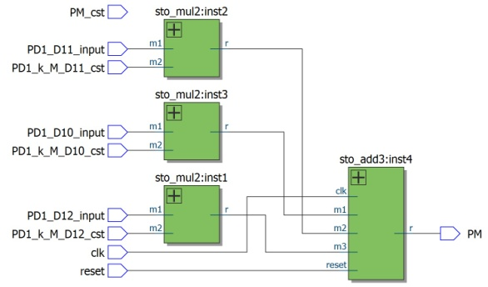
M1 : Architecture and compilers for stochastic machines
M1:
Circuit Architecture
High throughput RNG
M1:
Dimensioning
Experimental requirements

Slide 20
M2: Algorithms for stochastic search
M2: explore the search space for high probability density regions with generating sets:
Theory and formalization
Combination to build exploration policies
M2: Define appropriate search strategies in high dimensions
(ie: Source separation)

Slide 21
M3: Stochastic algorithms for the localization and the separation of sound sources
M3
Bayesian formalization source localization & separation
Specific models for source localization and separation addressing the problem of quantization

Slide 22
M4: Evaluation on simulated and real-world acoustic signals
M4:
Experimental setup
Quantitative evaluation & discussion
M4:
Compiler and Software
Algorithms

Slide 23
PhD
Year 1
Year 2
Year 3

Slide 24
Postdoc
Year 2
Year 3

Slide 25
Postdoc
Year 2
Year 3

Slide 26
Expected Results
Prototype of a programmable stochastic machine
New algorithms for stochastic inferences allowing to address a variety of applications
Demonstrations on two difficult tasks

Slide 27
Impact
Extracting precise information from large amount of noisy data is a general problem.
A success would lead to high performances devices (speed and energy consumption) for embedded systems:
sensor fusion & interpretation
Accelerometers , grid based approaches
telecommunication
PN acquisition
Decoding

Slide 28
Architecture for demanding applications
MicroBayes will lead to the making of a new type of programmable computer that can proactively interpret from large amount of noisy data with a good energy efficiency.
Patents (architecture – Compilation )
Stochastic machine kit
Local collaboration Xerox-CEA-ProbaYes

Slide 29
Dissemination
Scientific Paper and conferences
Mathematics
Computer science
ICC CC: cognitive computing Cognitive computing - big data - brain inspired computation
Robotics
IROS: robotics special issue : Special Issue on Unconventional computing for Bayesian inference
Signal audio
IEEE Transactions on Speech, Audio and Language Processing
EURASIP Journal on Advances in Signal Processing
Micro electronics
Async
DATE: Architecture design Architectural and Microarchitectural Design : power and energy efficient architectures
HPCA: architecture system Architectures for emerging technology and applications

Slide 30
MicroBayes
Four multi-disciplinary Labs
One PhD
One PostDoc
One prototype of a programmable Stochastic Machine
Two representative demos
Three scientific challenges
Architectures for stochastic machines
New inference algorithm
Difficult inference problems

Slide 31
The future Bayesian Valley ?

Slide 32
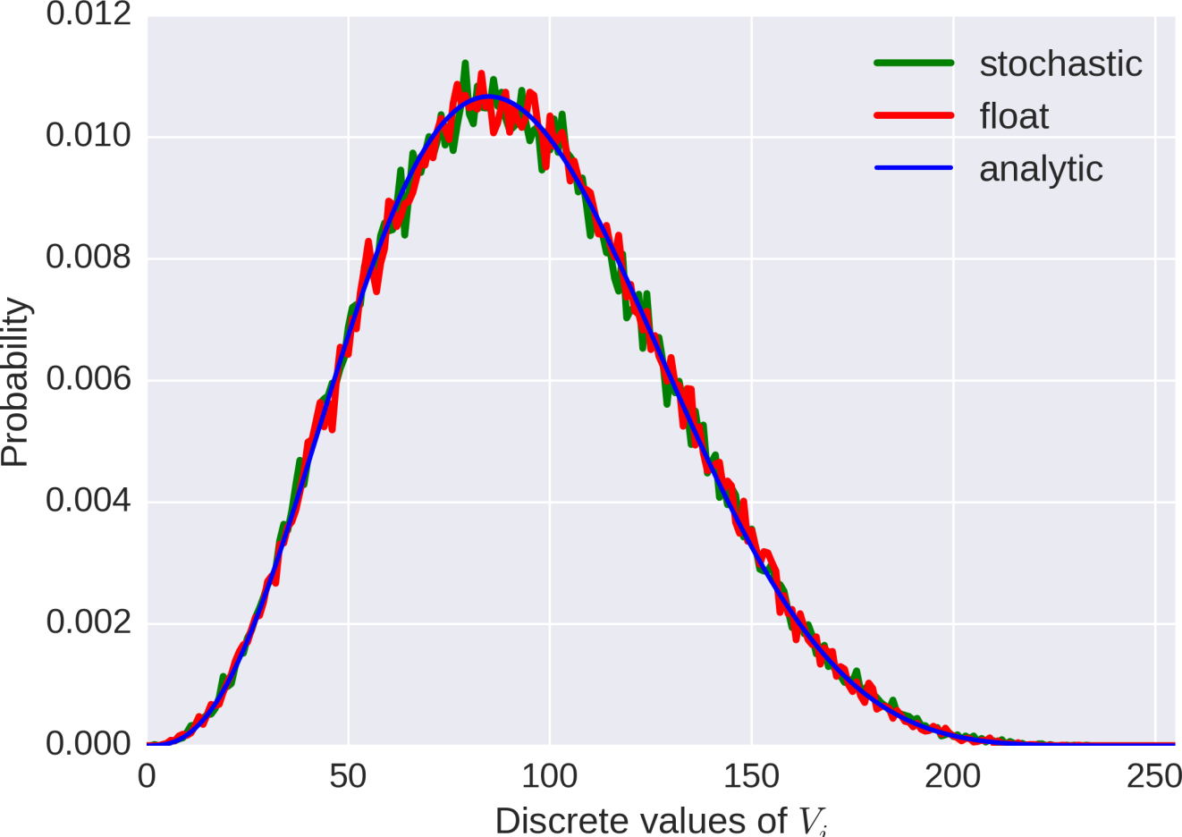
Exact Inference : sums

